Slide 1

DeepskyLog 5.0
What to expect

Slide 2
New Layout
Bootstrap
Responsive
Easy to use framework
TableSorter
Sorting
Sorting on multiple columns
Movable columns

Slide 3
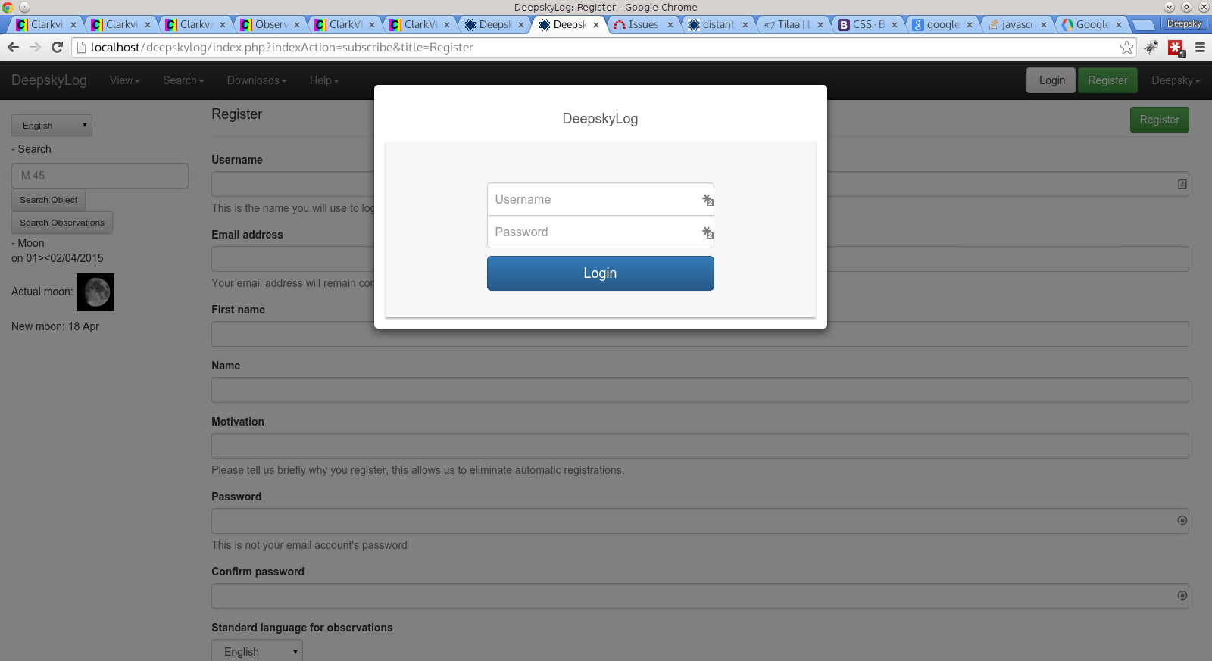

Slide 4
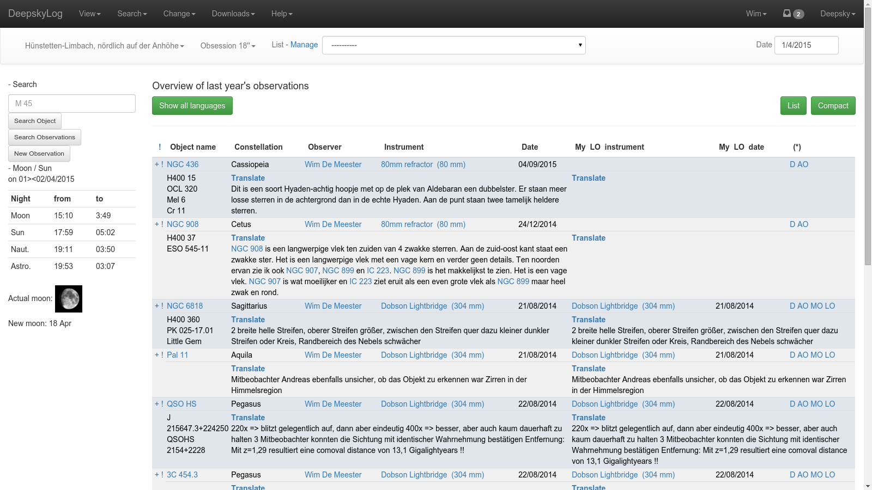

Slide 5
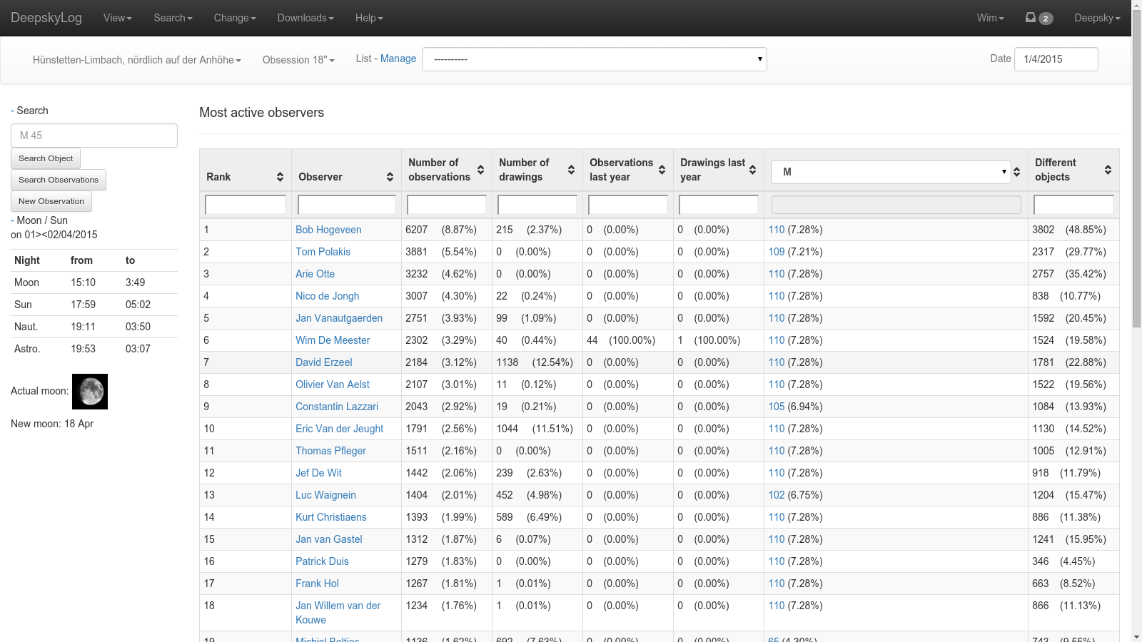

Slide 6
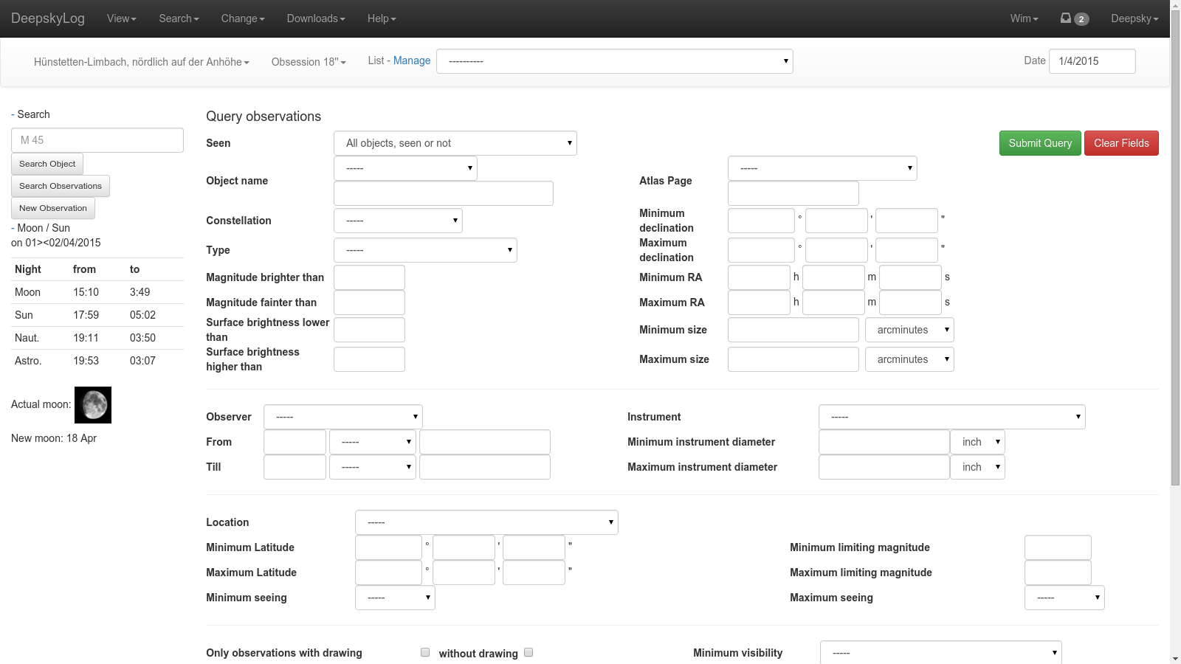

Slide 7
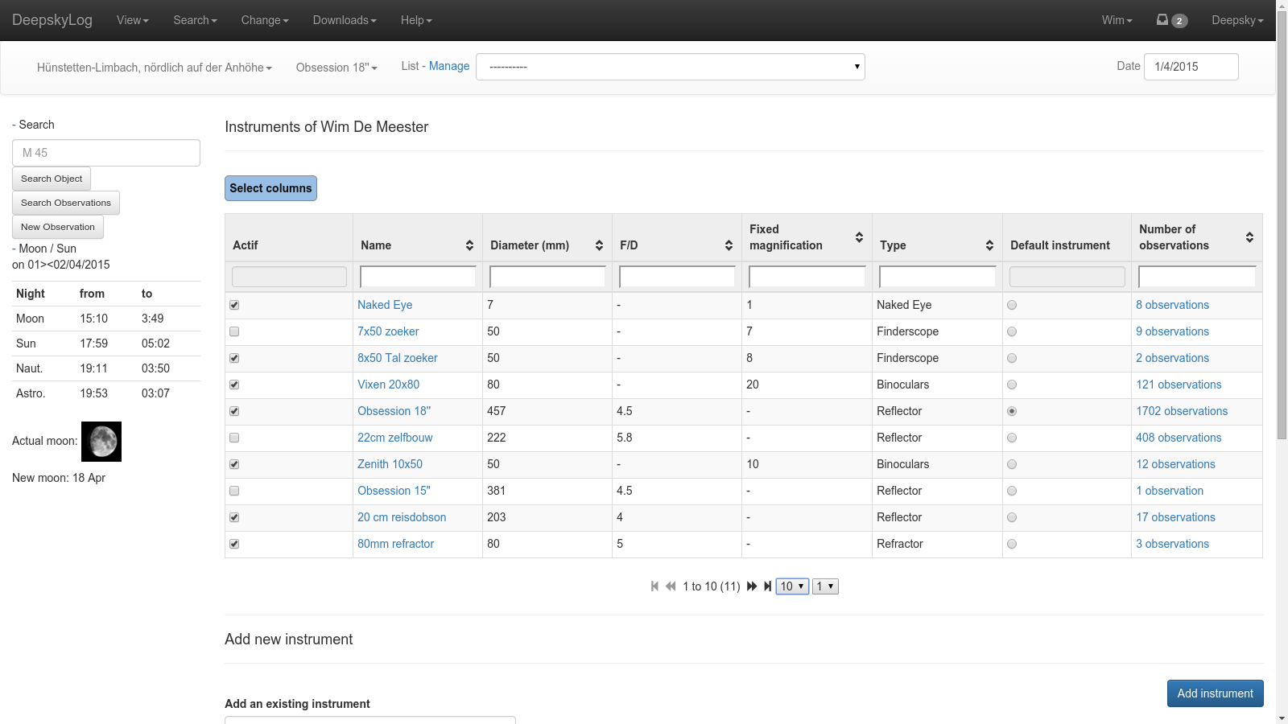

Slide 8
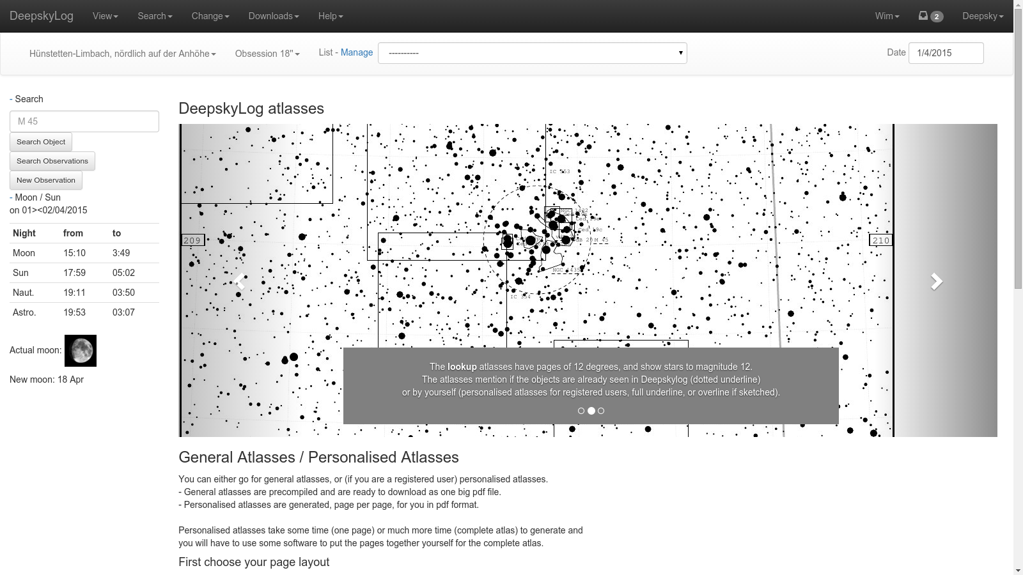

Slide 9
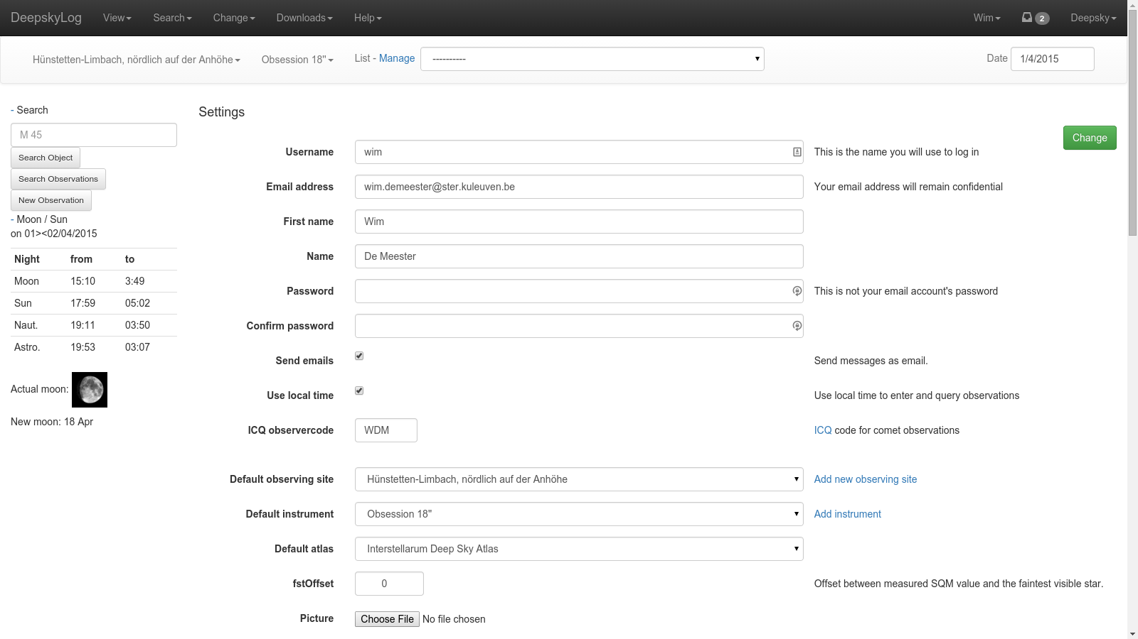

Slide 10
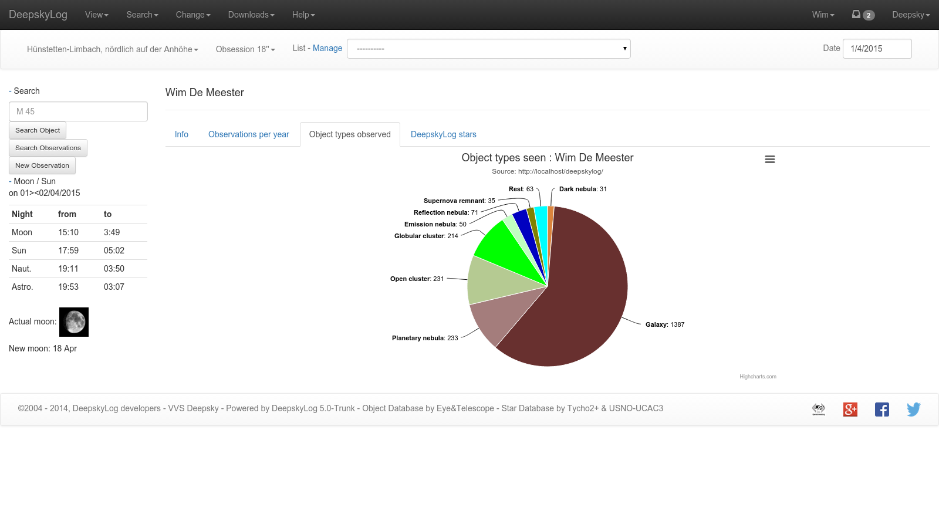

Slide 11
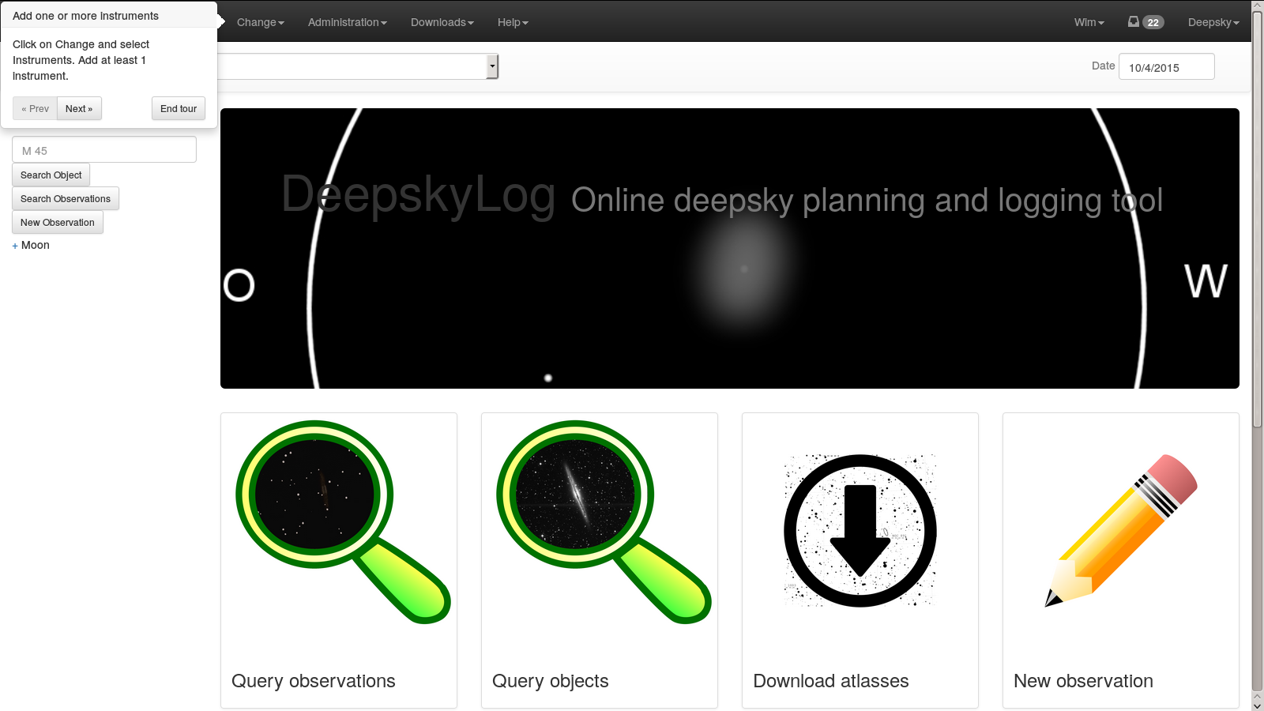

Slide 12
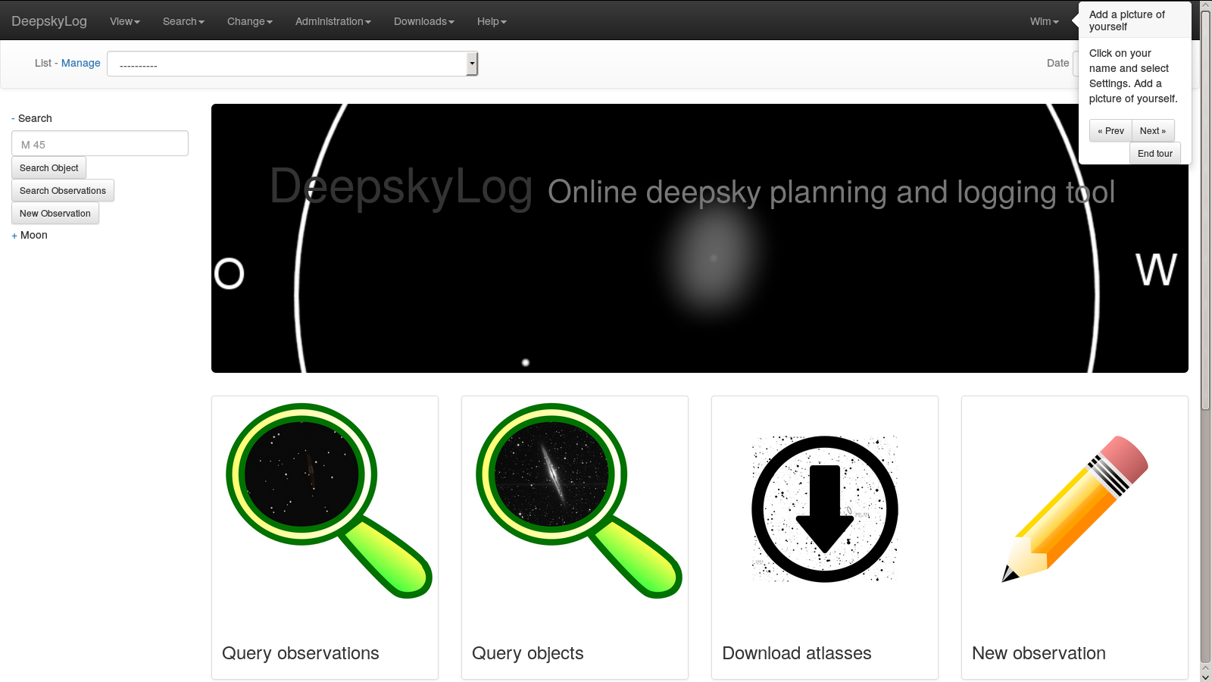

Slide 13
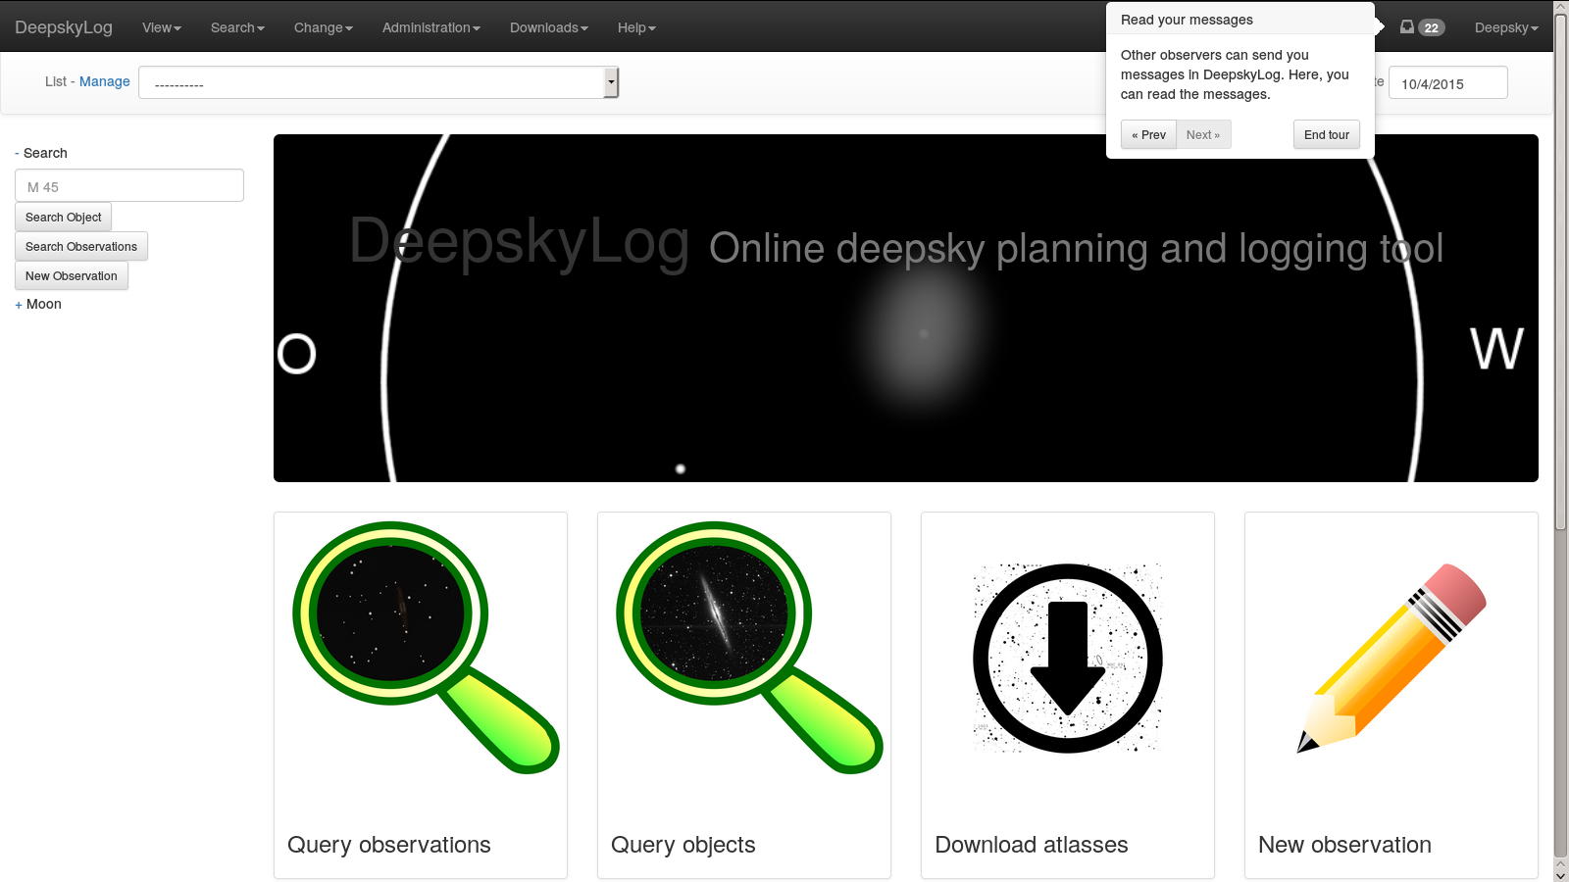

Slide 14
External libraries
jQuery | 1.11.2
jQuery-ui | 1.11.4
Bootstrap | 3.3.2
bootstrap-tour | 0.10.1
tablesorter | 2.18.4
lightbox | 2.7.1
Highcharts | 4.0.4

Slide 15
DeepskyLog Stars
Gamification
Automatic message
Deepsky and comets
Descriptions and drawings

Slide 16
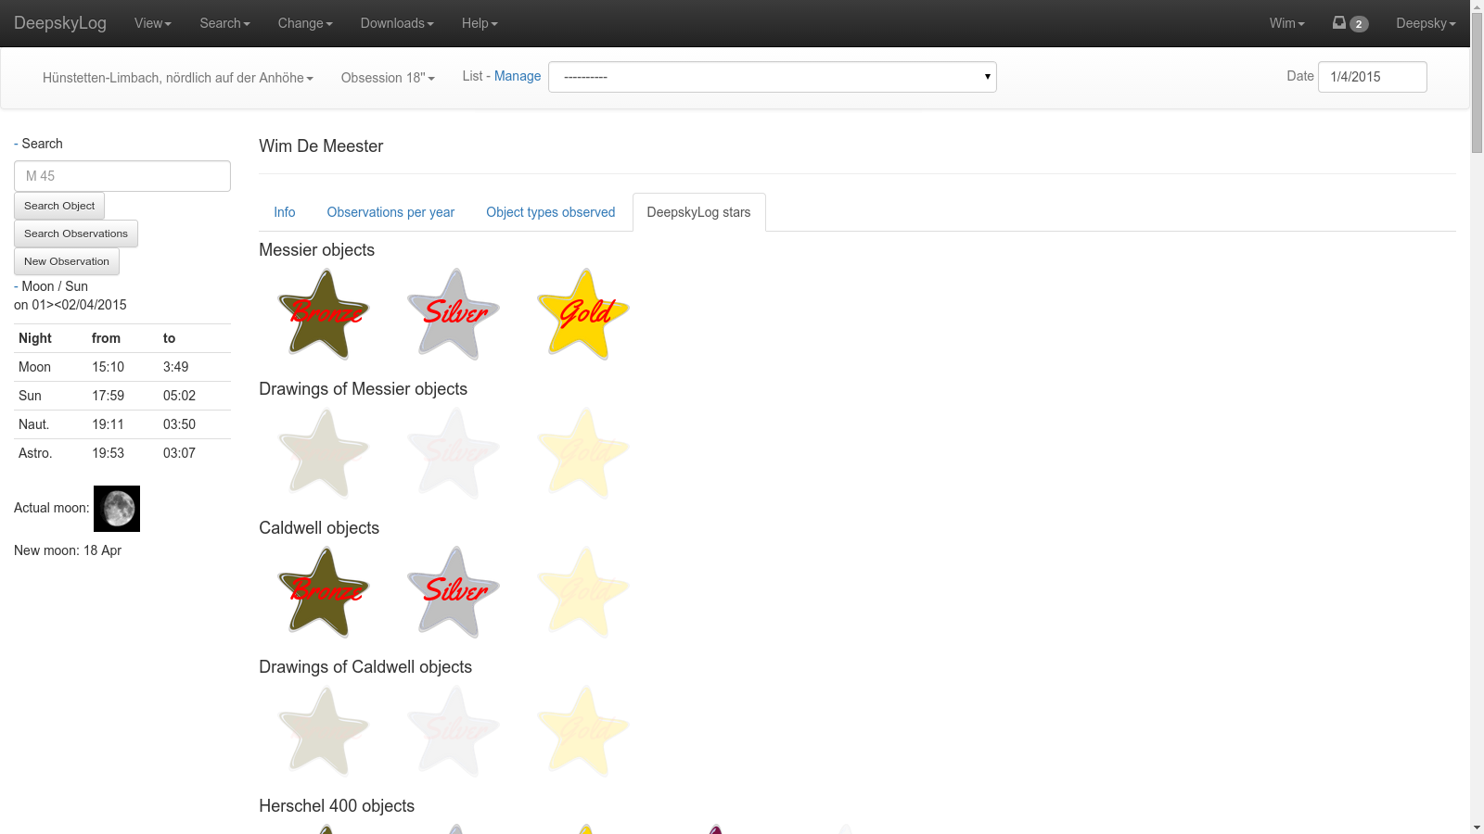

Slide 17
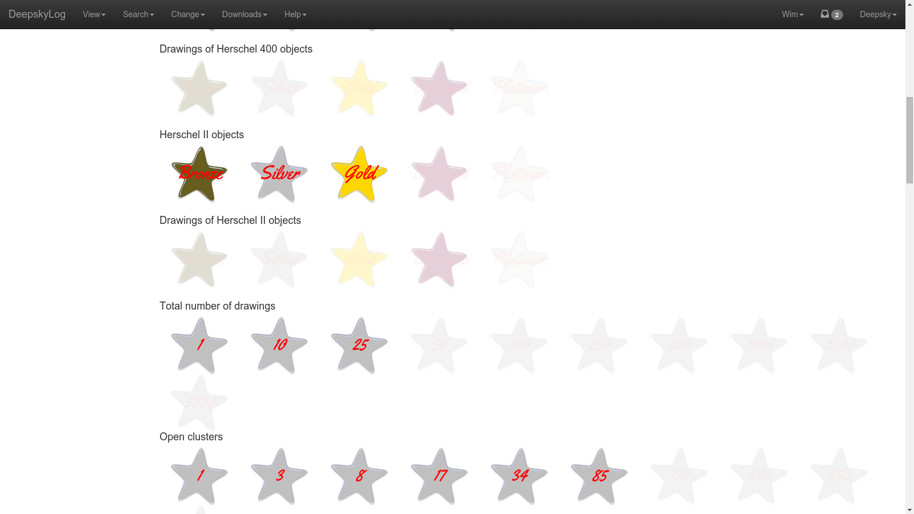

Slide 18
Use real emailaddress
Send message to real email address

Slide 20
Database access
Old mysql methods:
deprecated since php 5.5.
no longer developed since 2006
Migration to PDO_mysql

Slide 21
Picture of observers
In detail of observation.
In messages.

Slide 22
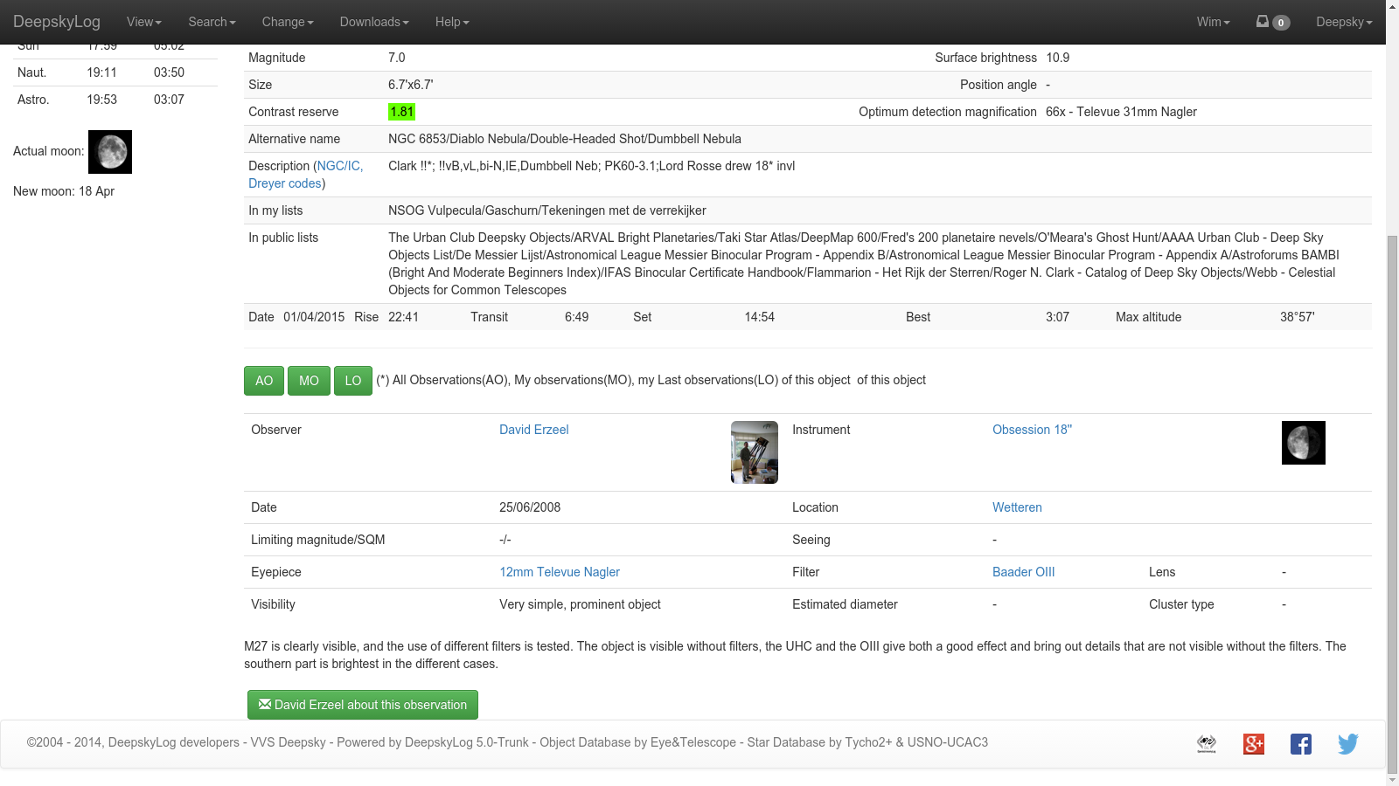

Slide 23
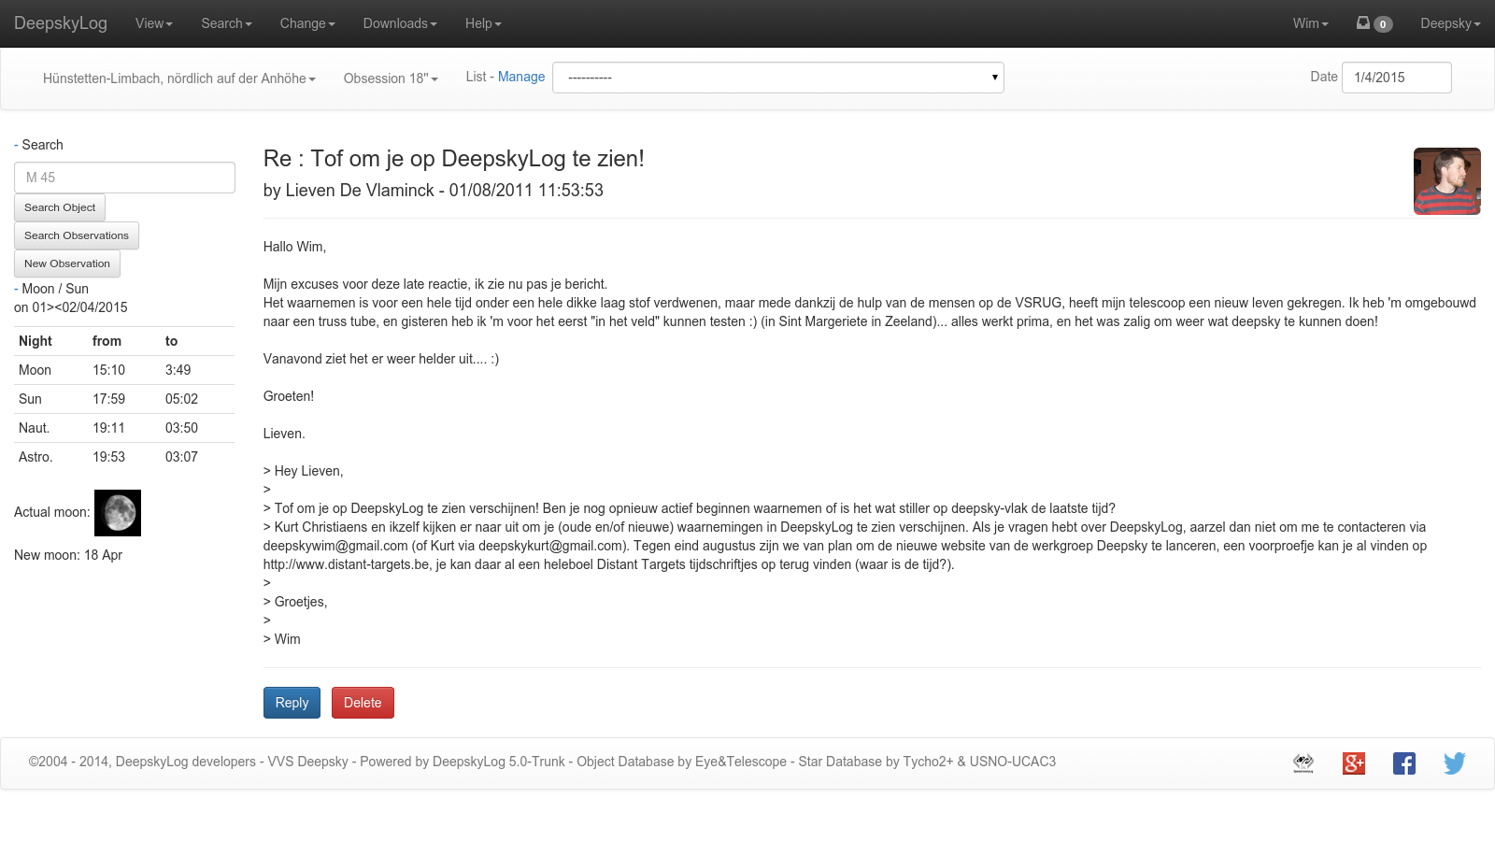

Slide 24

New Logo

Slide 25


New Logo

Slide 26
New entry page
Needs new logo

Slide 27
Add locations
Still todo:
Adapt location
Show locations on map, together with all other locations.
Write script to adapt the old locations
Import/export using OAL should use the elevation.

Slide 28
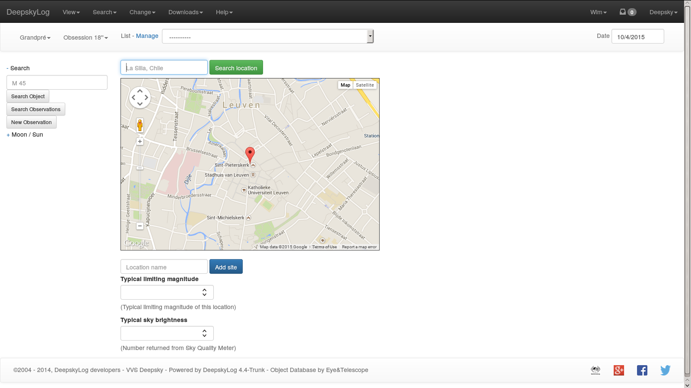

Slide 29
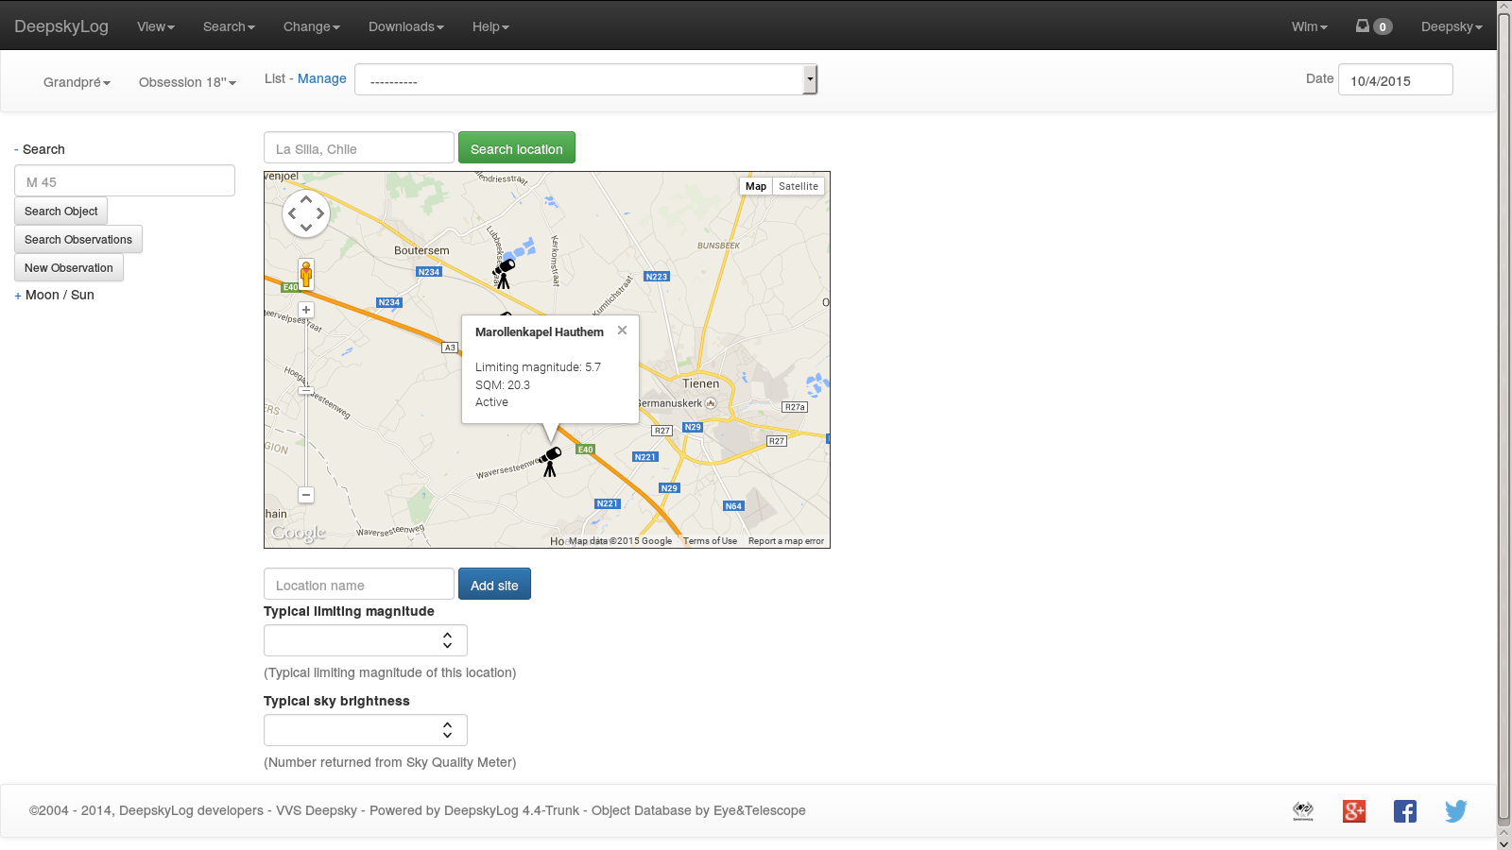

Slide 30
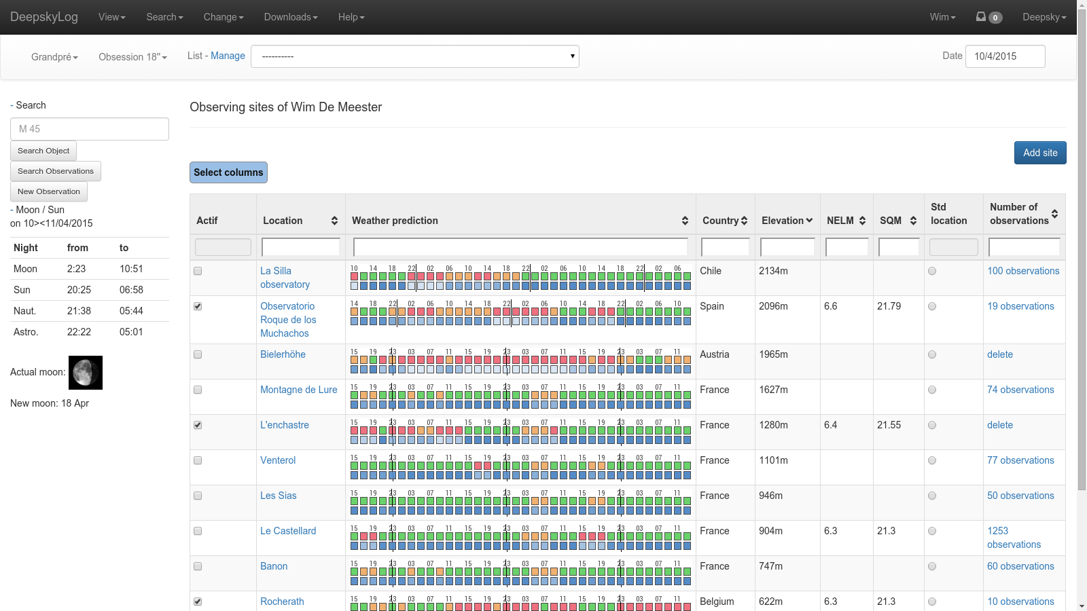

Slide 31
Status deepskylog.se
Person who would help with translation does not respond.
Contact person in Sweden will try to find someone else from the SAAF.
Most persons in Sweden speak English very well.

Slide 32
Questions
Database > 5 gigabyte, mostly in logging table

Slide 33
TODO
Only show part of the tables.
Finish new entry page.
Test, test, test!

